Slide 1

Errors and Exceptions

Slide 2
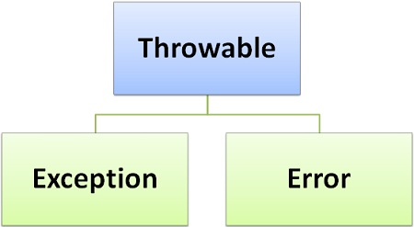
Python Exceptions
An exception is an error that happens during execution of a program.
When these exceptions occur, the Python interpreter stops the current process and passes it to the calling process until it is handled. If not handled, the program will crash.
Python provides a way to handle the Exception so that the other part of the code can be executed without any disruption.
Fig: Throwable as Exception and Error

Slide 3
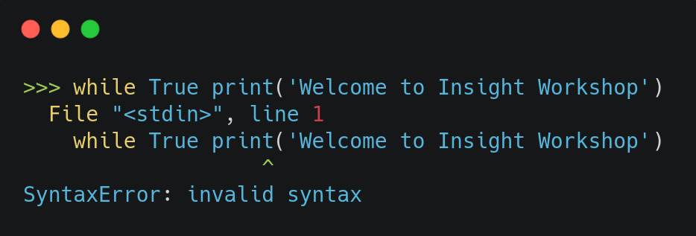
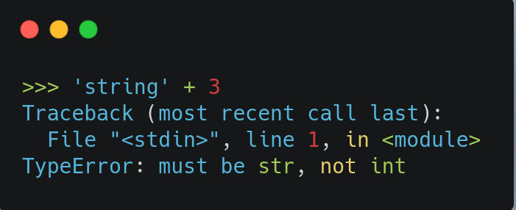
Syntax Error and Exceptions
The two distinguishable kinds of errors are:
Syntax Errors:
Syntax Errors occur when the parser detects an incorrect syntax or statement.
Exceptions:
Exception Errors occur whenever a syntactically correct Python code results in an error.
Some of the standard exceptions which are most seen include IndexError, ImportError, ZeroDivisionError, TypeError and so on
Fig: Syntax Error
Fig: TypeError Exception

Slide 4
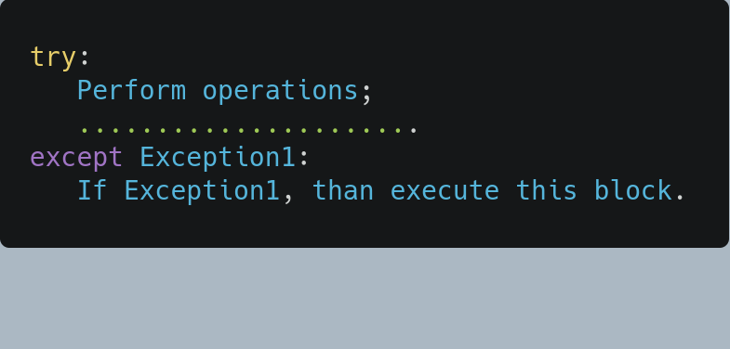
Handling Exceptions
Python uses try and except keywords to catch and handle exceptions.
The critical operation which can raise an exception is placed inside the try clause.
The code that handles the exceptions is written in the except clause.
First, the try clause is executed.
If no exception occurs, the except clause is skipped and execution of the try statement is finished.
If an exception occurs during execution of the try clause, the rest of the clause is skipped.
Fig: A simple syntax of try....except block
Fig: How try and except works?

Slide 5
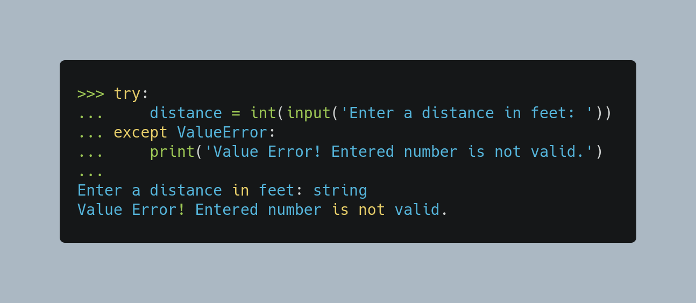
try and except Block
Fig: An example of try....except block

Slide 6
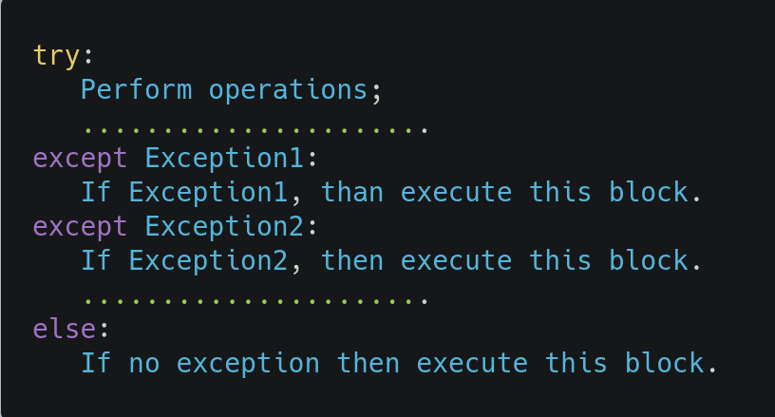
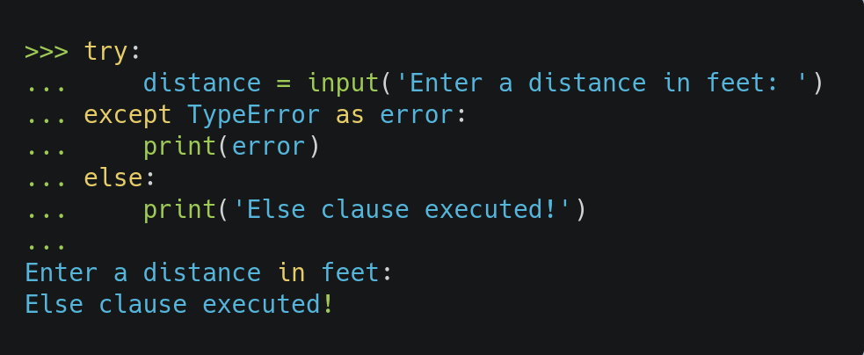
else Clause
A try statement may have more than one except clause, to specify handlers for different exceptions.
In the absence of exceptions, the else statement is used to instruct a program to execute a certain block of code.
Fig: Syntax of try....except...else block
Fig: A simple example of try....except...else block

Slide 7
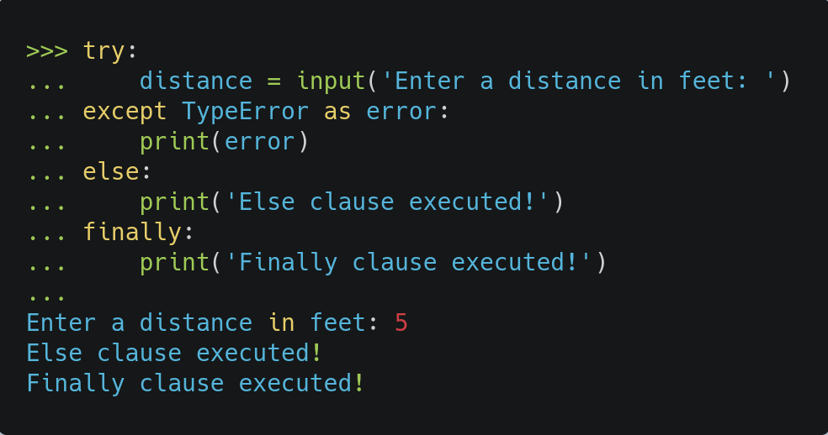
try-finally Clause
The finally clause implements some sort of action to clean up after executing our code.
If a finally clause is present, it will execute as the last task before the try statement completes.
finally enables us to execute sections of code that should always run, with or without any previously encountered exceptions.
Fig: Example of try....except...else...finally block

Slide 8
try, except, else and finally clause
try :
Run the code
except :
If exception match, execute this code
else :
No any exception match? Run this code
finally :
Always run this part of code
Fig: A simple flow chart to understand try....except...else...finally block

Slide 9
Some Common Exceptions
ValueError
TypeError
KeyError
AttributeError
ZeroDivisionError
IndexError
StopIteration

Slide 10
Task1
Take two numbers as input and add those numbers. Handle the possible exceptions.

Slide 11
Task2
Take two numbers input and divide a number by another number. Handle the possible exceptions.

Slide 12
Task3
Create a dictionary student with keys id, name, age, department. Take a input from the user, which info (id, name, age or department) he wants to access and print the result. Handle the possible exceptions.

Slide 13
Task4
Create a function to check whether a input character is vowel or not. Handle the possible exceptions.

Slide 14
File I/O Handling

Slide 15
Files in Python
While working in a software application project, in most cases we create, read and write files to store information.
Two common types of file in Python are Text File and Binary File.
Text Files | Binary Files
Web standards: html, XML, CSS, JSON etc. Source code: c, app, js, py, java etc. Documents: txt, tex, RTF etc. Tabular data: csv, tsv etc. Configuration: ini, cfg, reg etc. | Document files: .pdf, .doc, .xls etc. Image files: .png, .jpg, .gif, .bmp, .jpeg etc. Video files: .mp4, .3gp, .mkv, .avi etc. Audio files: .mp3, .wav, .mka, .aac etc. Database files: .mdb, .accde, .frm, .sqlite etc. Archive files: .zip, .rar, .iso, .7z etc. Executable files: .exe, .dll, .class etc.

Slide 16
Python File Handling Operations
If we want to manipulate a file, we need to first open it.
A basic steps for python file handling operations are
Open a file
Read or write
Close the file
Python has an in-built functions to open, read, write and close a file.

Slide 17
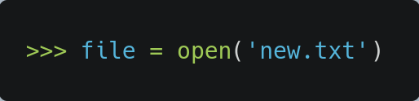
Opening a File in Python
Python has a built-in open() function to open a file.
open() has a single required argument that is the path to the file. open() has a single return, the file object.
mode is an optional string that specifies in which mode the file is opened. The default mode is 'r' which means open to read in text mode.
Syntax:
file_object = open(file_name, mode)
Fig: Open the newfile.txt

Slide 18
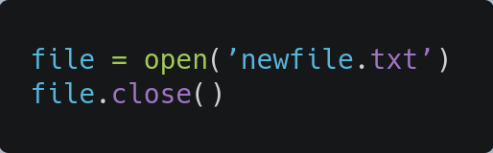
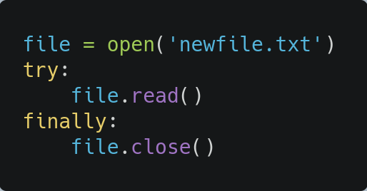
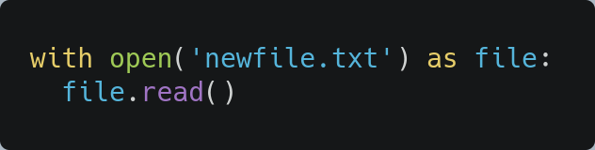
Closing a File in Python
close() function to close it.
We should always make sure that an open file is properly closed.
If not closed properly, it may lead to the unwanted activities such as resource leaks.
Some ways that can ensure that a file is closed properly are:
1. Using try-finally block:
2. Using with statement:
Fig: Close the newfile.txt
As, we learned in the exception handling, finally code block always runs in the program.
Fig: Using try-finally block
It makes code cleaner and handles the unexpected errors easily.
The with statement automatically takes care of closing the file.
Fig: Using with block

Slide 19
Opening file modes
We can define an argument to represent how we want to open the file. The available modes are:
Character | Meaning
'r' | open for reading (default)
'w' | open for writing, truncating the file first
'x' | open for exclusive creation, failing if the file already exists
'a' | open for writing, appending to the end of the file if it exists
'b' | binary mode
't' | text mode (default)
'+' | open for updating (reading and writing)

Slide 20
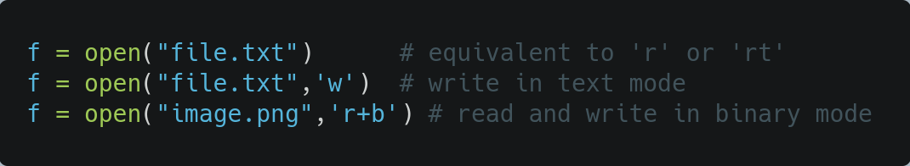
Binary and Text Mode
Python distinguishes between binary and text I/O.
In text mode, we get strings when reading from the file.
While, binary mode returns bytes objects without any encoding.
Binary mode is used to deal with non-text files like images or executable files.

Slide 21
Reading Files in Python
We can use the read(size) method to read with a defined number of data.
If no argument or None or –1 is passed in the size parameter, the whole file is read.
There are multiple methods that can be called on a file object for reading.
Method | Usage
.read(size=1) | This reads from the file based on the number of size bytes.
.readline() | This reads individual lines of a file. This method reads a file till the newline, including the newline character.
.readlines() | This reads the remaining lines from the file object and returns them as a list.

Slide 22
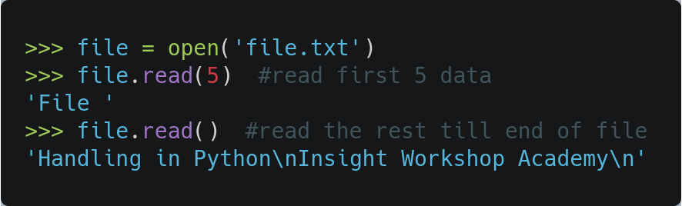
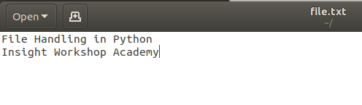
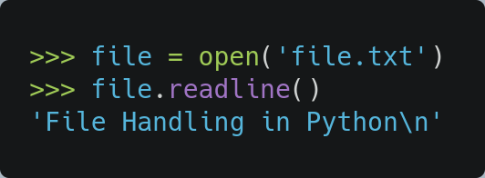
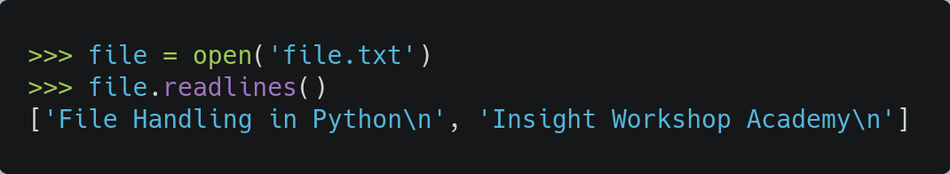
Reading Files in Python...
Let's read an existing file 'file.txt' and use the common read methods.
read() method returns a newline as '\n'
Fig: Existing 'file.txt' file
Fig: Using readline() method
Fig: Using readlines() method

Slide 23
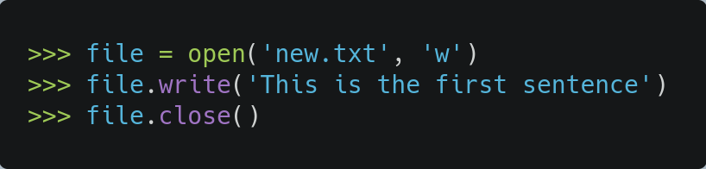
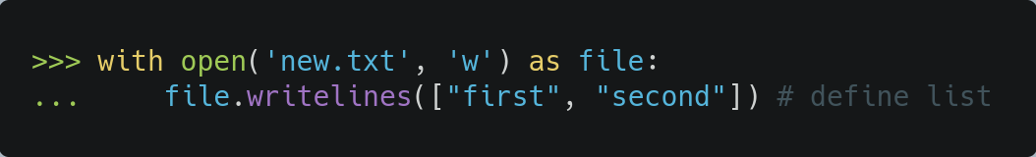
Writing Files in Python
Some of the methods that are useful for writing to a file are:
Let's write a file named 'new.txt' using the write() method.
Method | Usage
.write(string) | This writes the string to the file.
.writelines(seq) | This writes the sequence to the file. No line endings are appended.
Fig: Using writelines() method
Fig: Using write() method

Slide 24
Other Python File Methods
There are other several methods available with the file object.
We can simply play around with these methods to know how it works.
Method | Description
close() | Closes an opened file. It has no effect if the file is already closed.
seek(offset,from=SEEK_SET) | Changes the file position to offset bytes, in reference to from (start, current, end).
seekable() | Returns True if the file stream supports random access.
tell() | Returns the current file location.
truncate(size=None) | Resizes the file stream to size bytes. If size is not specified, resizes to current location.
detach() | Separates the underlying binary buffer from the TextIOBase and returns it.
fileno() | Returns an integer number (file descriptor) of the file.
flush() | Flushes the write buffer of the file stream.
Fig: List of some file methods

Slide 25


Slide 26
CSV Handling

Slide 27
CSV Files
A CSV file consists of rows of text.
Each row consisting of values separated by a delimiter character, typically a comma (,) or a tab.
One of the most popular file formats for exchanging data is the CSV format. Therefore, learning how to handle csv files can be a blessing in future.
Name,Email,Address,Phone
admin,abcd@gmail.com,Kathmandu,98111114551
Fig: CSV file sample data

Slide 28
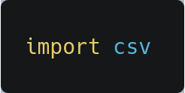
CSV Handling
Python provides a csv module which implements classes and functions to read and write tabular data in CSV format.
The csv module’s reader and writer objects read and write sequences.
We need to first import csv module to use methods.
Some useful functions provided by csv module to read and write data are:
Some useful classes provided by csv module are:
csv.reader() and csv.writer()
csv.DictReader() and csv.DictWriter()

Slide 29
CSV module built in functions
In python CSV module documentation we can find following functions:
Functions | Purpose
csv.field_size_limit | return maximum field size
csv.get_dialect | get the dialect which is associated with the name
csv.reader | read data from a csv file
csv.list_dialects | show all registered dialects
csv.register_dialect | associate dialect with name
csv.writer | write data to a csv file
csv.QUOTE_ALL | Quote everything, regardless of type.
csv.unregister_dialect | delete the dialect associated with the name the dialect registry
csv.QUOTE_MINIMAL | Quote fields with special characters
csv.QUOTE_NONNUMERIC | Quote all fields that aren't numbers value
csv.QUOTE_NONE | Don't quote anything in output

Slide 30
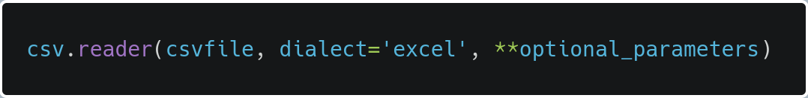
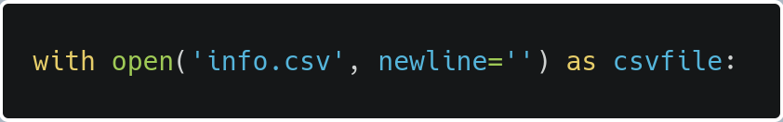
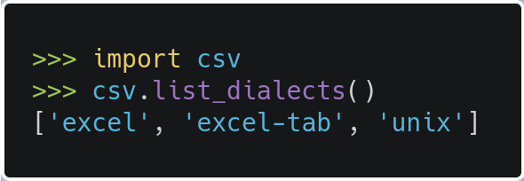
csv.reader()
The complete syntax of the csv.reader() function is:
It returns a reader object which will iterate over lines in the given csvfile.
csvfile can be a file object or list objects which supports the iterator rule.
If csvfile is a file object, it should be opened with newline=''.
An optional dialect is a set of parameters used to define the format of a CSV file.

Slide 31
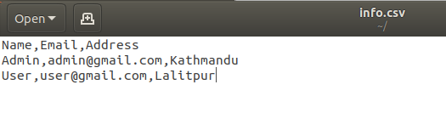
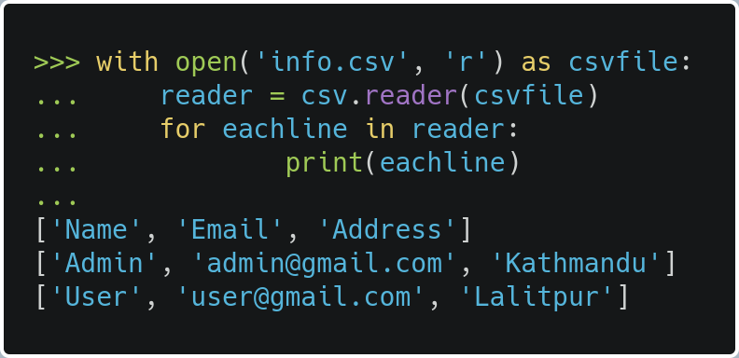
Reading CSV files
Comma Separated Values
Fig: info.csv file in text editor view
We can use the csv.reader() function to read a CSV file in Python.
Suppose we have a csv file named 'info.csv' having user information.
To read a csv file, let's use csv.reader() function.
Reading CSV Having Comma (,) Delimiter
The csv.reader() returns an iterable reader object.
The reader object is then iterated using a for loop to print the contents of each line.
Excel Tabular Format
Name | Email | Address
Admin | admin@gmail.com | Kathmandu
User | user@gmail.com | Lalitpur
Fig: info.csv file with sample user data
Fig: reading info.csv file

Slide 32
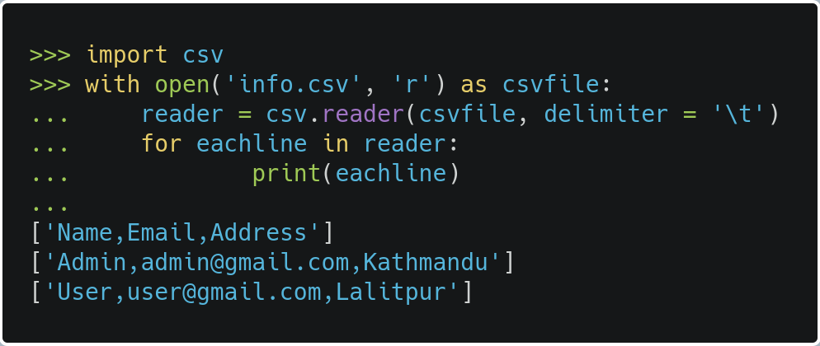
Reading CSV files
Excel Tabular Format
Read CSV file Having Tab Delimiter
The only difference is adding the optional parameter delimiter = '\t'
Name | Email | Address
Admin | admin@gmail.com | Kathmandu
User | user@gmail.com | Lalitpur
Fig: info.csv file with sample user data
Fig: reading info.csv file

Slide 33
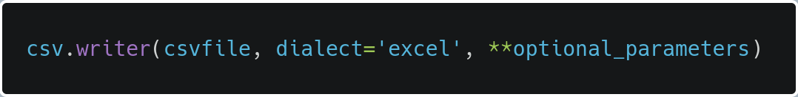
csv.writer()
The complete syntax of the csv.writer() function is:
It return a writer object to convert the user’s data into delimited strings on the given file-like object.
csvfile can be any object with a write() method.
If csvfile is a file object, it should be opened with newline=''.
An optional dialect is a set of parameters used to define the format of a CSV file.

Slide 34
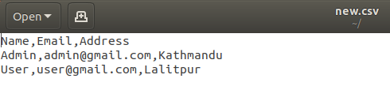
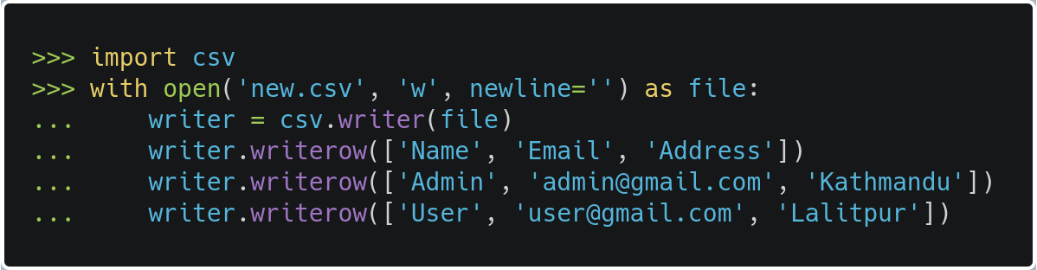
Writing CSV files
Comma Separated Values
We can use the csv.writer() function to write a CSV file in Python.
The csv.writer() function returns a writer object that converts the user's data into a delimited string.
This string can later be used to write into CSV files using the writerow() function.
Fig: new.csv file in text editor view
Excel Tabular Format
Name | Email | Address
Admin | admin@gmail.com | Kathmandu
User | user@gmail.com | Lalitpur
Fig: new.csv file with sample user data
Fig: Writing new.csv file

